Slide 1
Planet People Product Partners

Slide 2
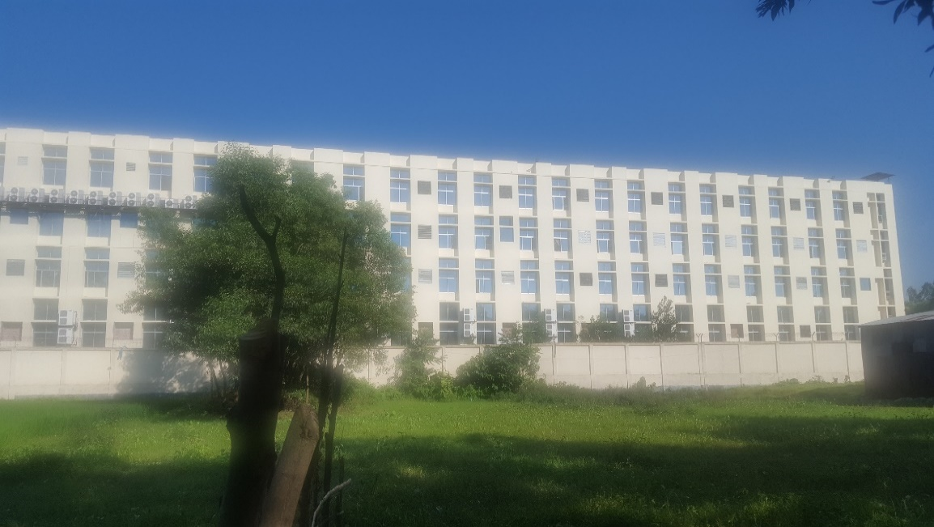
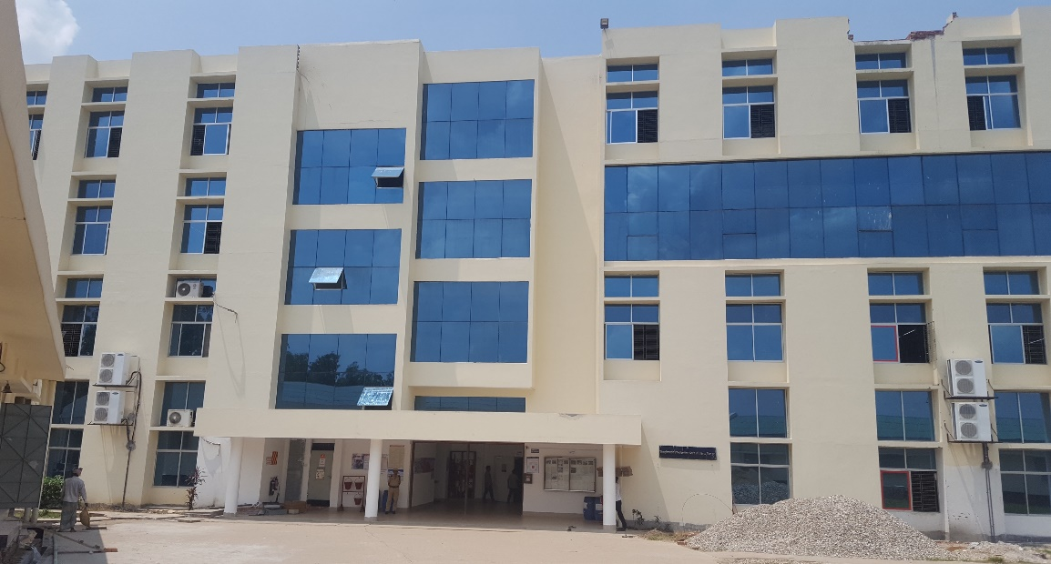
Factory Photos

Slide 3
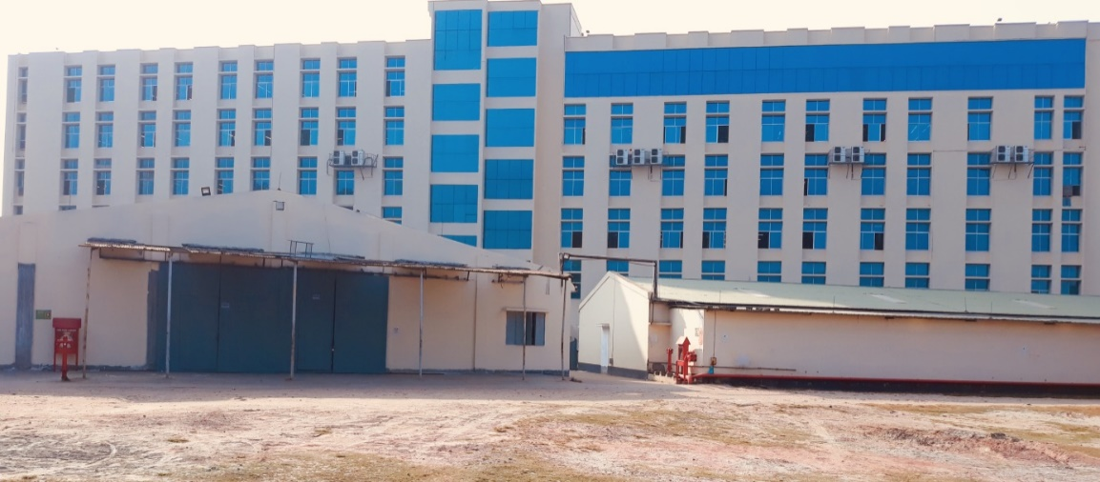
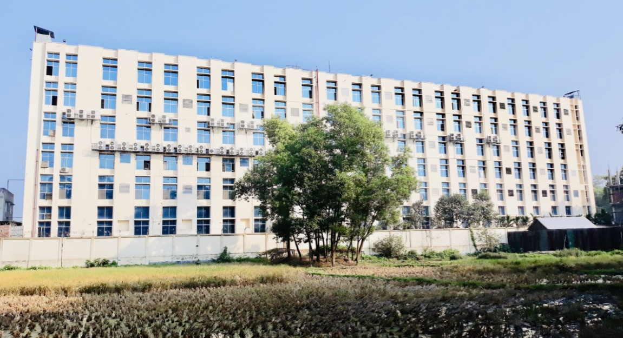
Factory Photos After Expansion in 2018
Take a 360 Virtual Tour at https://fourcornersbd.com/360/echo/

Slide 4
About Us
We are a world-class compliant knitwear (sweater) manufacturing unit with utmost attention to taking care of our employees and being friendly to the planet.
We started our journey in 1993 as Shomahar Sweaters Ltd with 104 knitting machines and a workforce of 150 workers. We now employ around 2360 personnel and we aim to turnover $30 million in 2022-23. We have 600 Shima Seiki (Japan) automated jacquard machines serving a more diversified market which includes Europe, South America, North America, Australasia and Asia.
Being among the first generation of sweater manufacturers in Bangladesh enabled us to create and maintain an extensive track record for superior quality, technical know-how and on-time delivery.
We believe our 29 years experience, flexibility to adapt to fashion and customer focus will enable us to enhance our market positioning. We have a long term relationship with our buyers and many of them has been our partners for over a decade.
Fact Profile
Production Capacity: 500,000 pieces per month and 6 million pieces in a year, it can vary depending on the timing of the product.
Product Range: includes 3GG, 5GG, 7GG, 10GG, 12GG and 14GG. We produce for mens, ladies and kids with various of knit patterns such as moss, pique, milano, full needle, rib, cable, jacquard knit etc.
Minimum Order Quantity: 3000 PCs per style, 1000 PCs per colour.
In-house facilities: Washing with ETP, Drying, Steam Ironing. We outsource Dying, Printing, and Embroidery.
Yarn: Organic Cotton, BCI Cotton, Recycled cotton polyester blends, Sustainable wool, Merino wool, Lambswool nylon, Cashmere, Viscose Nylon Polyester (PBT), Mossy yarn, Tape yarns, Viscose Nylon, fancy yarn with various blends which are consistently evolving with fashion trends

Slide 5
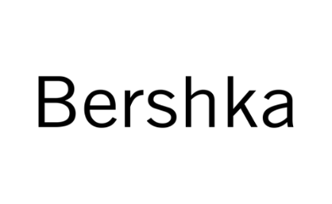














Customers / Buyers

Slide 6



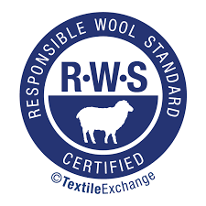

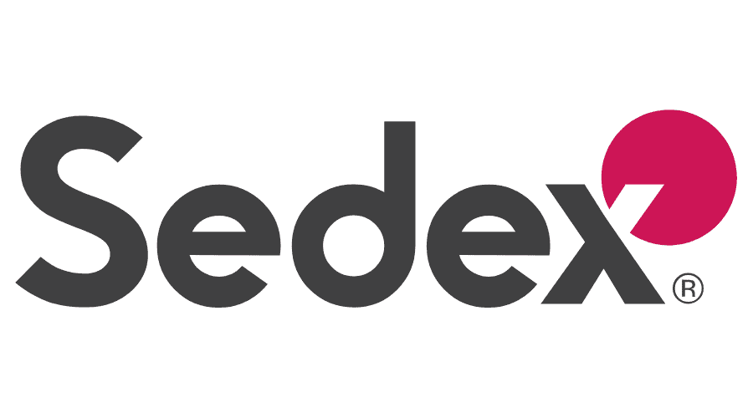



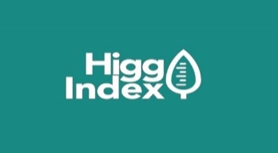


Audits & Certificates
We are an Accord audited factory and have BSCI, ICS, Sedex, Better Work (ILO) and GSV Certification (covers CT-PAT standards) as compliance certifications. We also have BCI, GOTS, GRS and RWS for producing organic, recycled and sustainable wool products. For the environment we are enrolled to the Higg Index and Zero Discharge of Hazardous Chemicals (ZDHC) initiatives.

Slide 7
Infrastructure, Safety & Green Initiatives
Infrastructure
Echoknits Ltd. is situated in Kaliakoir, Gazipur on its own premises of 3.5 acres of land. The production space in the main building consists of 1,80,000 sq ft and it is around 2,25,000 sq ft. (approx) including ancillary facilities. The purpose-built facility was planned with core emphasis on international compliance standards. Our premises also has fully equipped Helipad.
Take a 360 Virtual Tour at www.fourcornersbd.com/360/echo/
Energy
We get our electricity from REB grid and our current consumption is 1050 KW. We have 3 back up generators with combined capacity 1768 KW in case of power failure. We also have online UPS with capacity 640 KW to ensure uninterrupted power supply to our automated knitting machines.
We plan to generate 25% of our electricity using Solar technology by 2023 and 50% by 2025.
Fire, Health and Safety:
Bus Bar Trucking(BBT) System with 99% less chance for short circuit.
Smoke Detection installed according to Accord standards.
Fire Hydrant installed according to Accord standards.
Sprinkler system installed according to Accord standards.
We have installed Italian Fire Doors from Ninz Italy.
50% more space allocated for Aisle and Stairways
Department and Zone wise Training by Fire Services.

Slide 8
Infrastructure, Safety & Green Initiatives
Green Initiatives:
More than 50% of our premises contains plantation and greenery.
95% of the lights in the entire praises is LED lights which saves 60% electricity, 1% from Solar Panels and we are working on going heavy on Solar.
We have an Effluent Treatment Plant (ETP) & planning for Water Recycling Mechanism.
We have partnered with Forbes Marshall, a specialized US company, and implemented Condensation Return System to recycle steam from our finishing section using trap methods.
We have individual switch for individual worker so maximum energy is saved.
Plantation of 23 types of vegetables and fruits inside the Premises.
We are undertaking initiative for rainwater harvesting, water recycling and solar installations.
Employee Welfare:
Building has been designed as such that it allows Maximum Air/ Wind and Light circulation with around 50% of the structure being windows.
Day Care for Worker’s Children
Free Medical Care
Working with SNV on Sexual Reproductive Health and Rights (SRHR) and providing counselling to our workers to improve their health, prevent diseases and guide them in their family planning.
Invested a significant sum in developing our Medical care with all related equipment to take care of covid 19 patients.

Slide 9
Infrastructure, Safety & Green Initiatives
Financial Inclusion:
We are the 2nd factory in Bangladesh to have a Bank inside our premises. Usually you will find ATMs inside the factory premises but after permission from the Central Bank (BB) we have a branch of Bank Asia within our premises were our workers can access all kind of banking facilities.
We made several training and awareness programmes with Swiss Contact and Sharati to teach workers how to save money and manage their personal finances. This has led to an increase amount of saving.
They can send money to their village at lower cost, without using informal channels.
Less dealing in cash has given our employees full control over spending leading to financial independence.

Slide 10
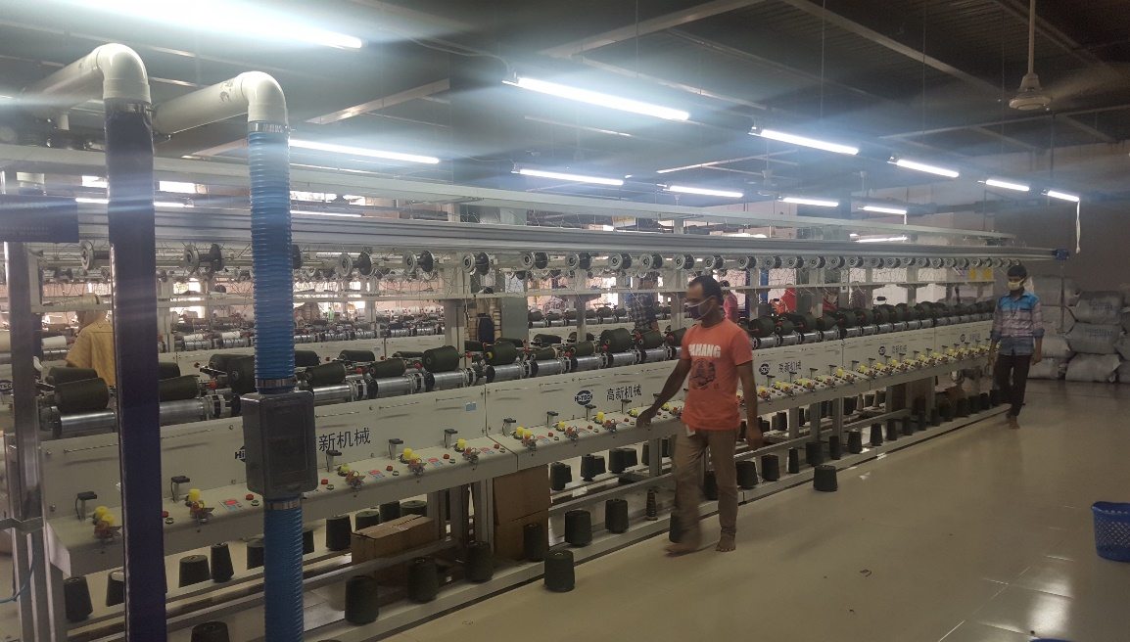
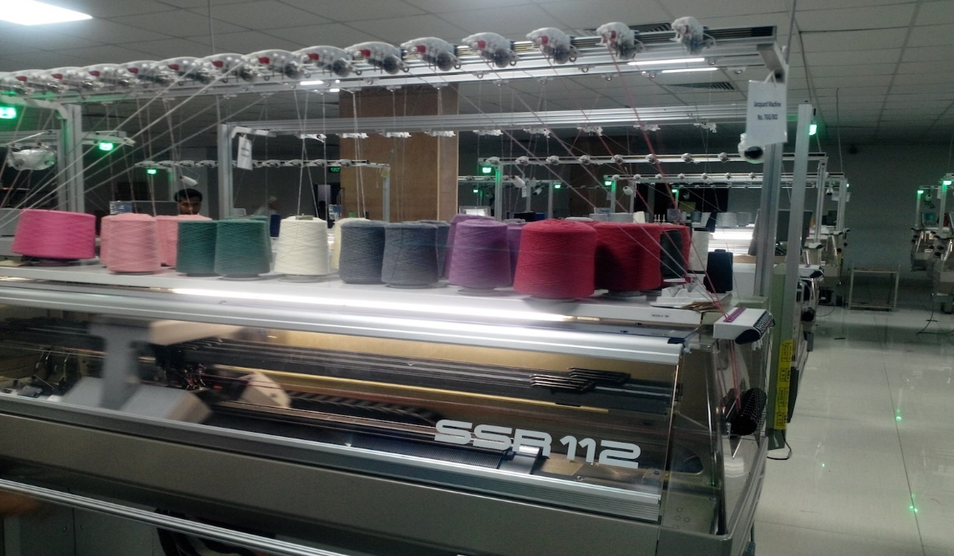
Winding and Knitting Section

Slide 11
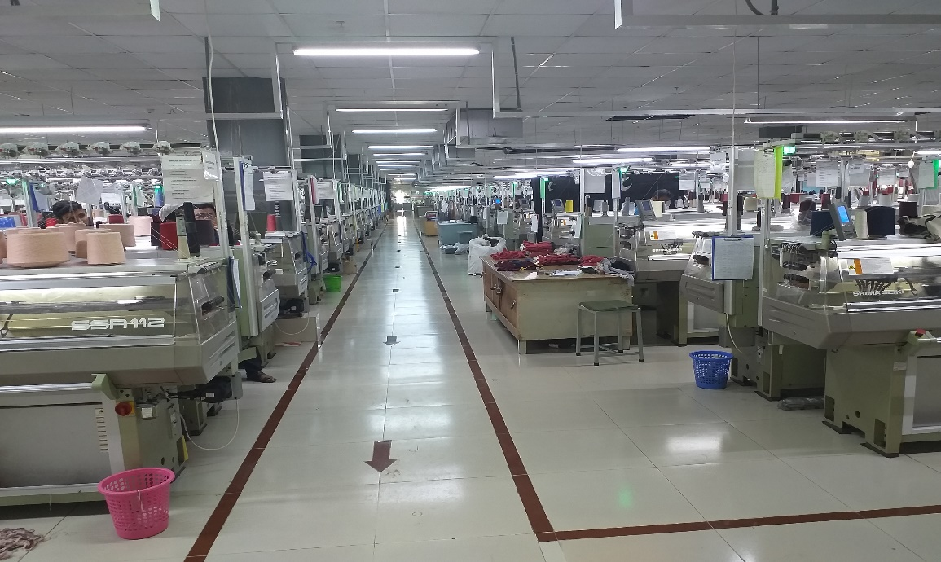
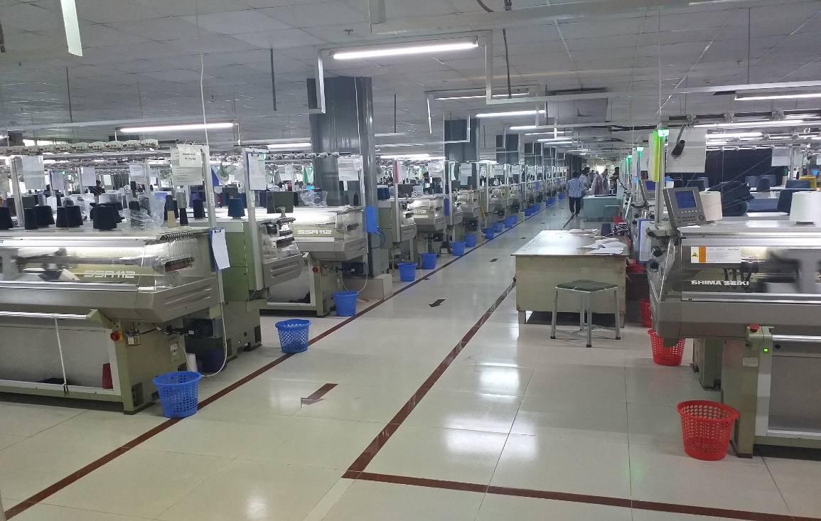
Knitting Section

Slide 12
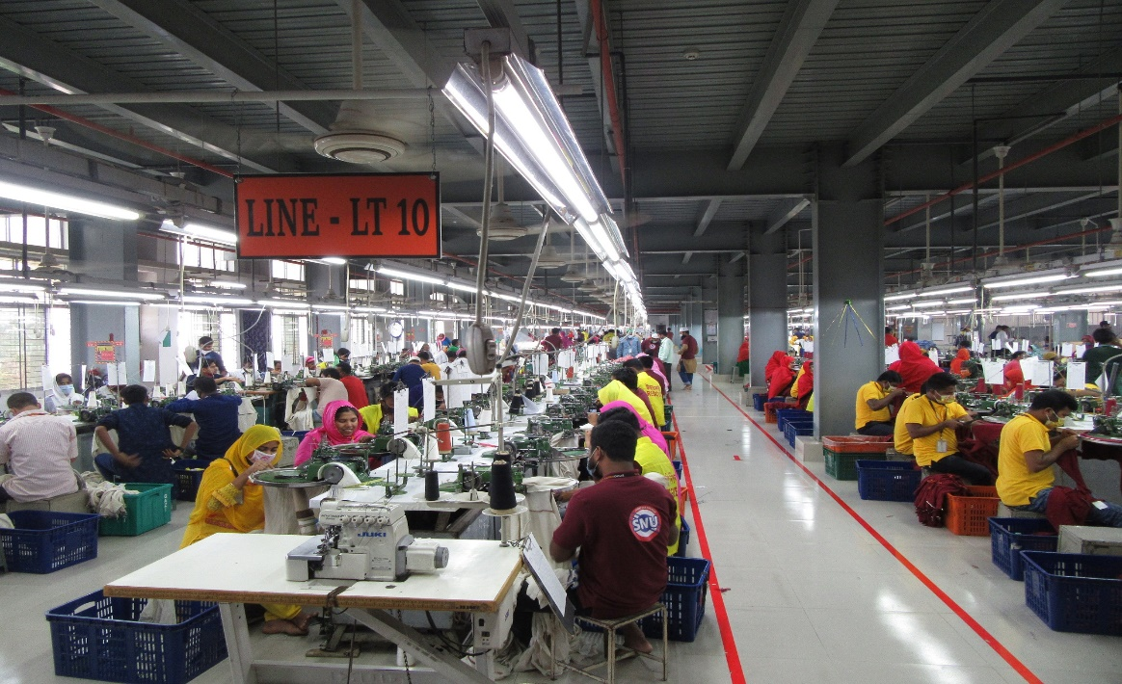
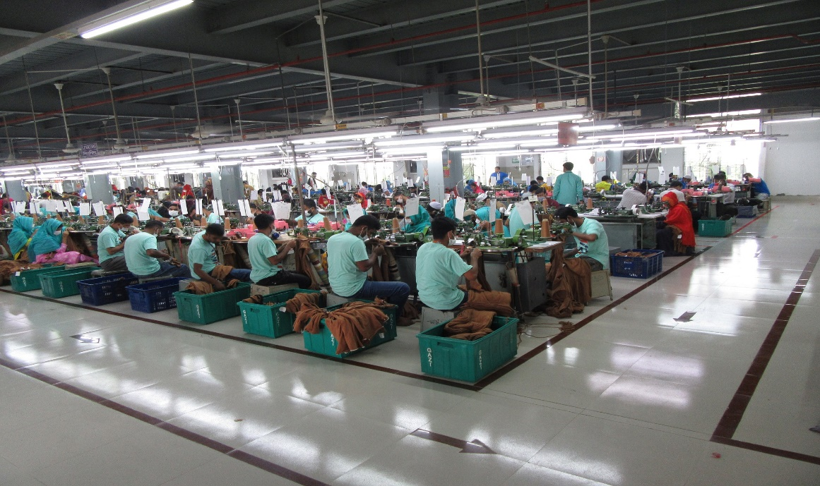
Assembling Section (Linking)

Slide 13
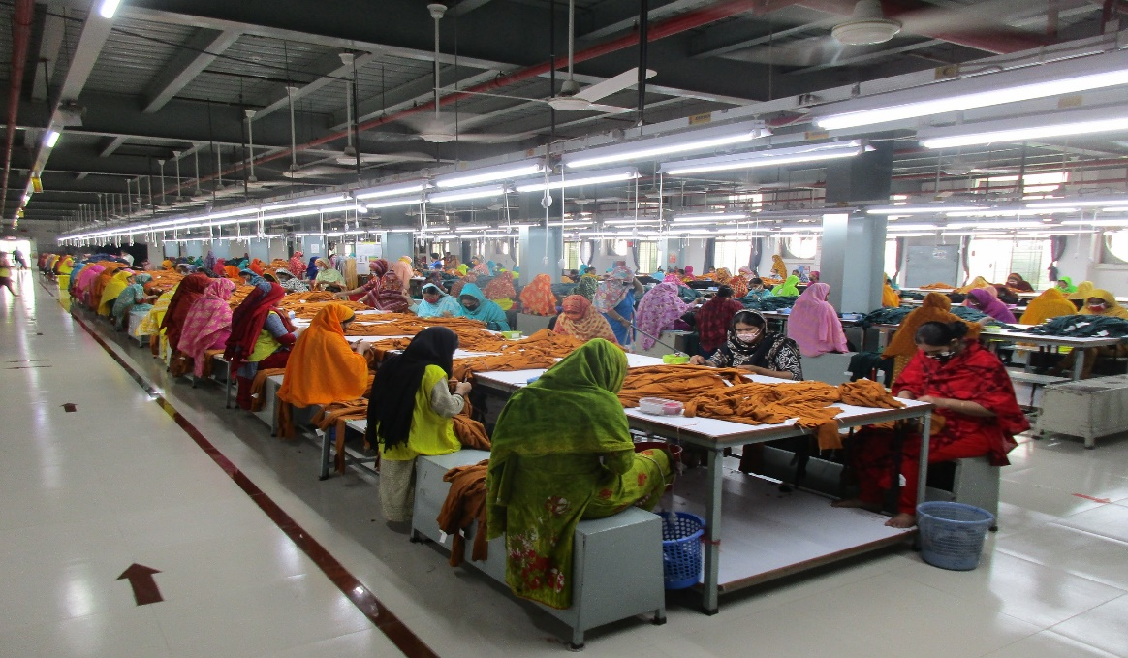
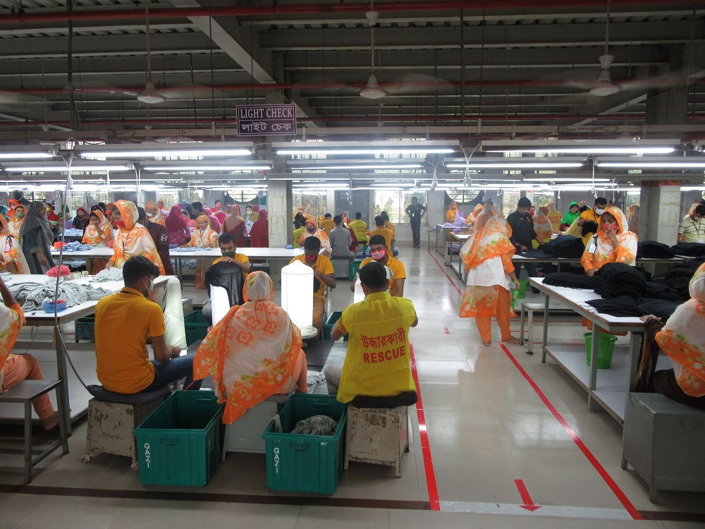
Assembling Section (Trimming & Mending)

Slide 14
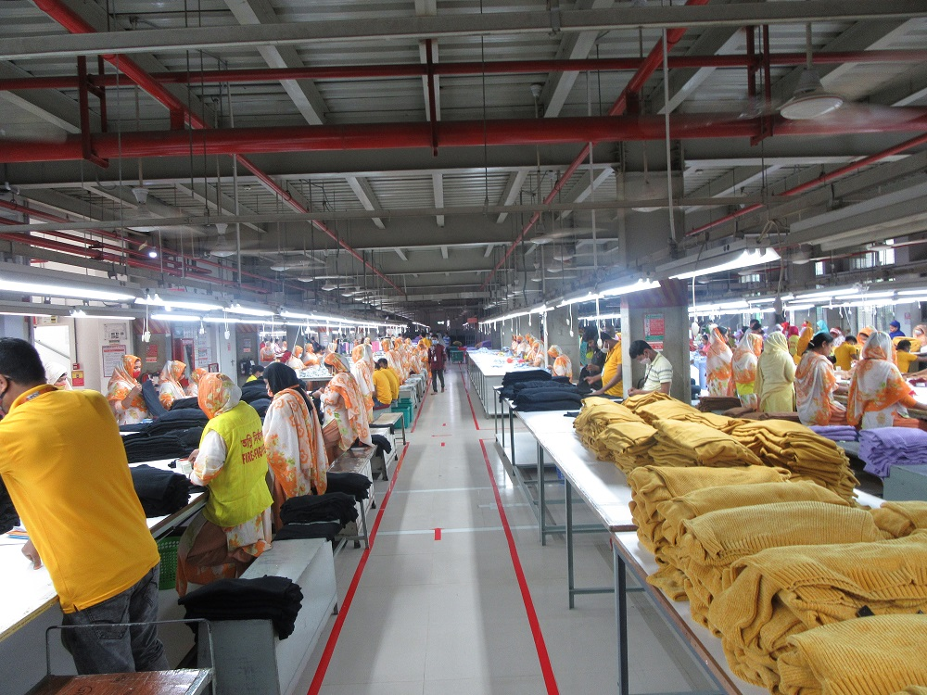
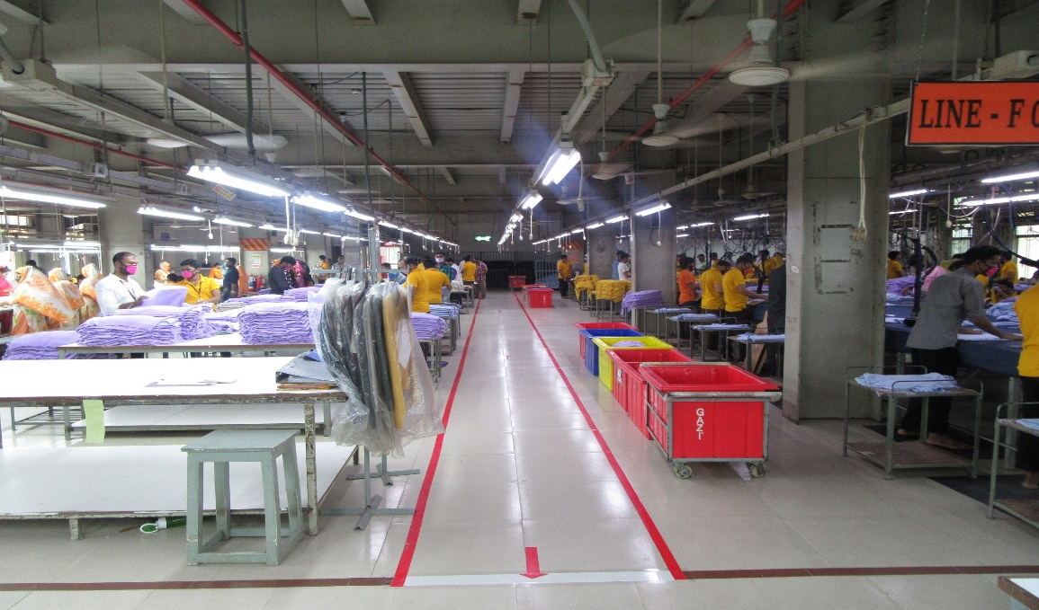
Finishing Section

Slide 15
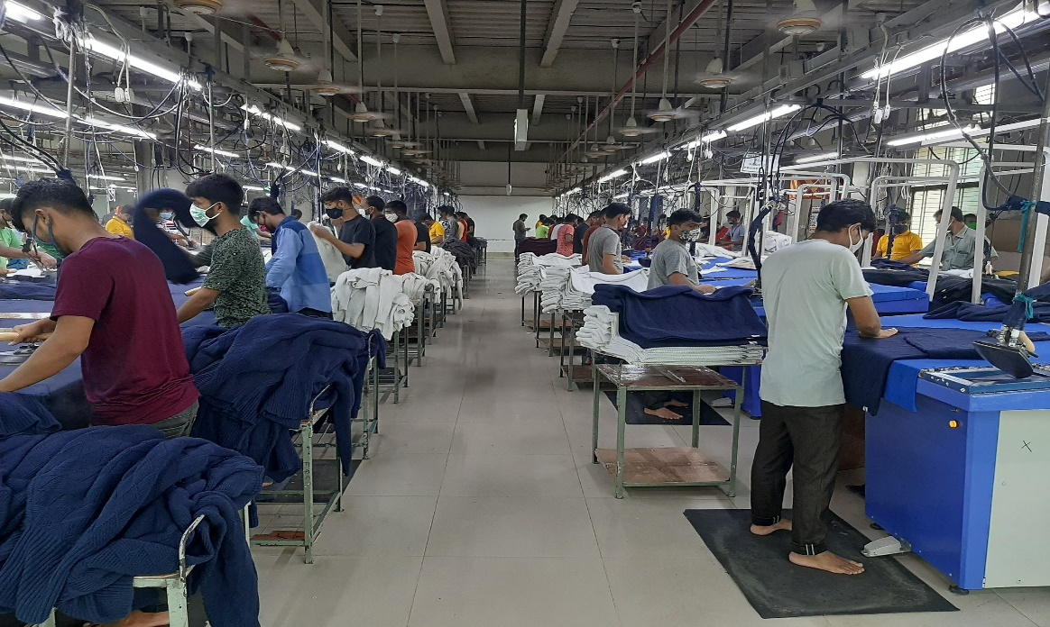
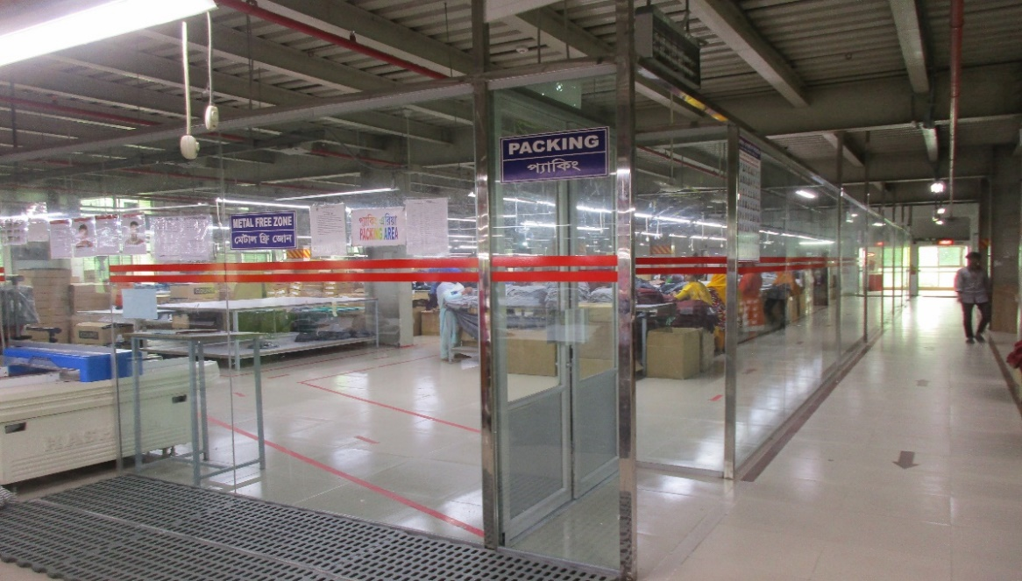
Finishing Section

Slide 16
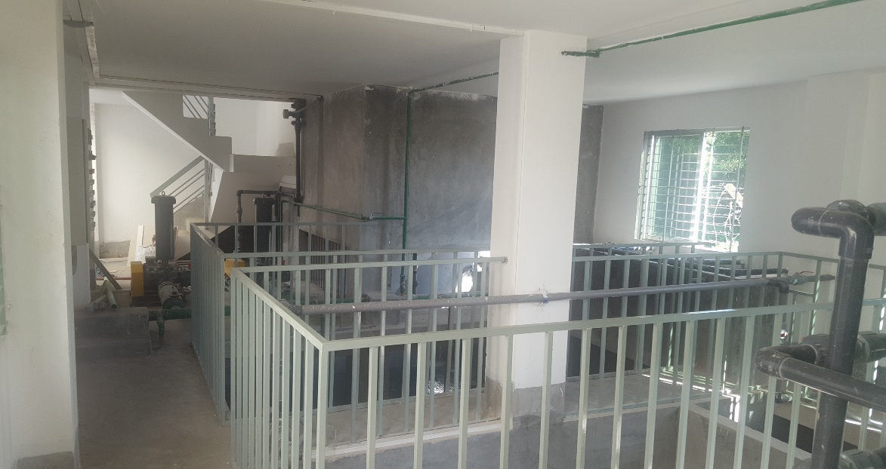
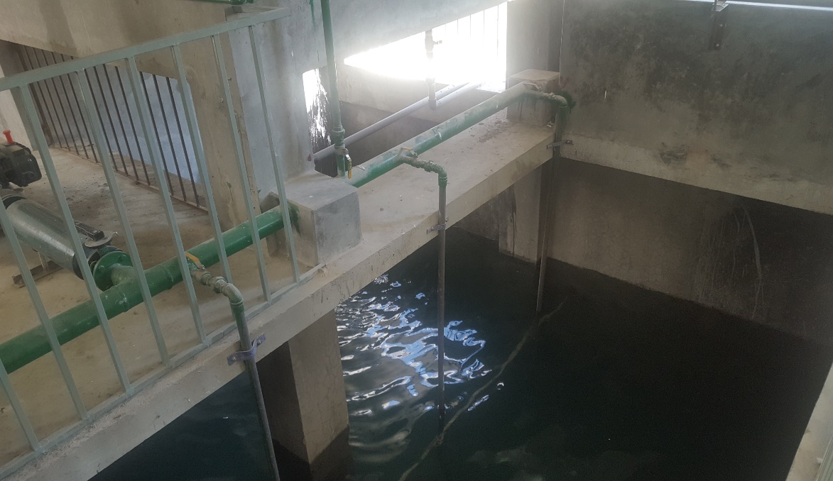
Effluent Treatment Plant (ETP)
provide our stakeholders with satisfactory service. At the moment we located in the heart of Dhaka in Area. It consists of 75,000 square feet area with an annual production capacity of 1 million pieces. We turned over around $5million in 2010/11.

Slide 17
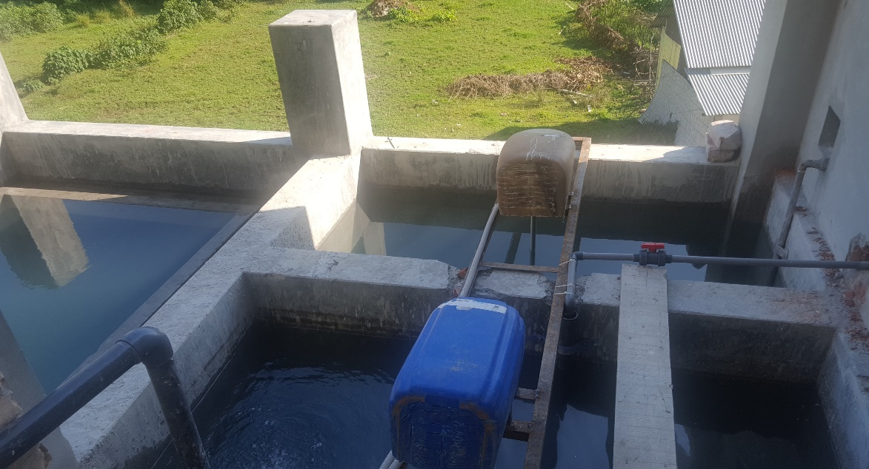
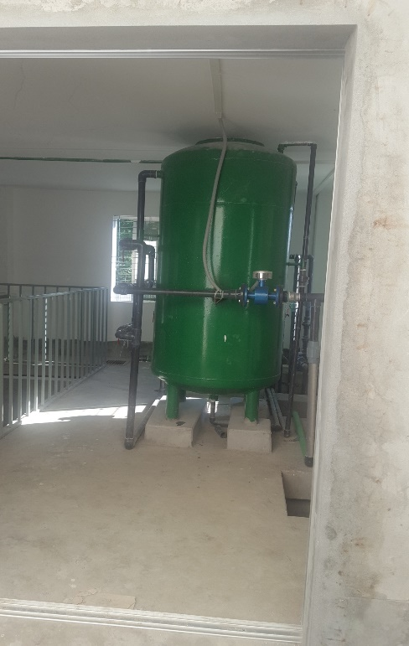
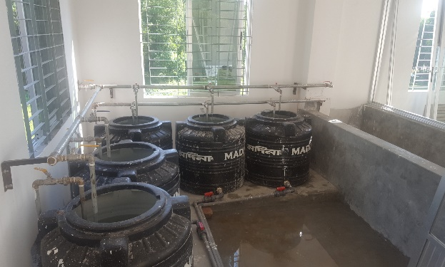
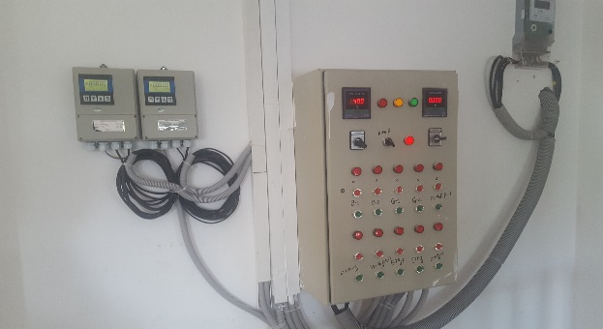
Effluent Treatment Plant (ETP)
provide our stakeholders with satisfactory service. At the moment we located in the heart of Dhaka in Area. It consists of 75,000 square feet area with an annual production capacity of 1 million pieces. We turned over around $5million in 2010/11.

Slide 18
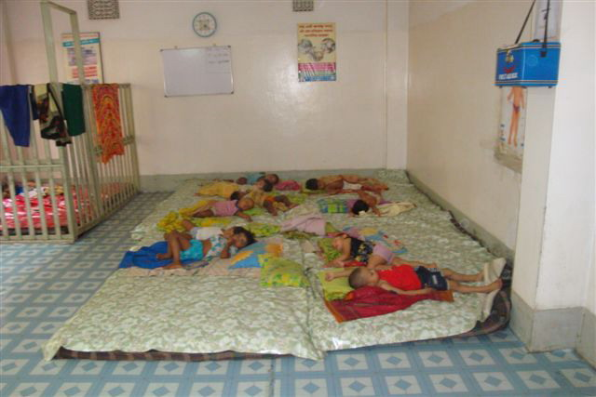
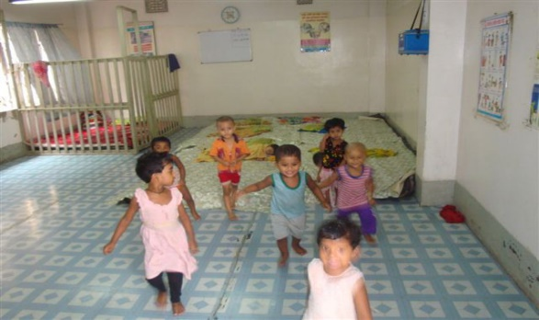
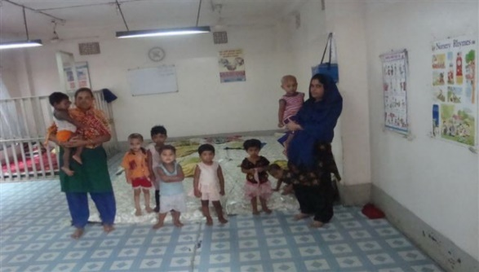
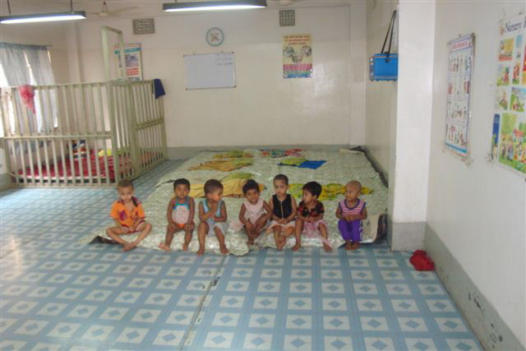
Our Beloved Day Care
provide our stakeholders with satisfactory service. At the moment we located in the heart of Dhaka in Area. It consists of 75,000 square feet area with an annual production capacity of 1 million pieces. We turned over around $5million in 2010/11.

Slide 19
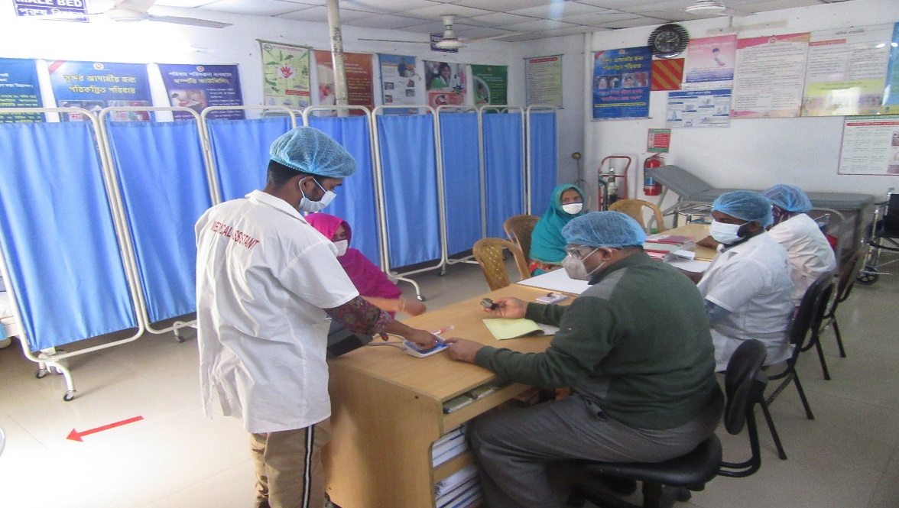
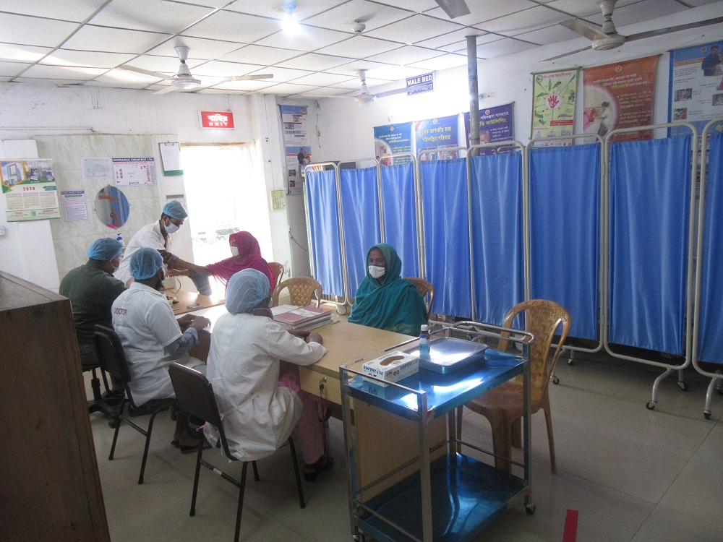
Medical Center

Slide 20
Awards / Recognition
Worked with Swiss Contact and Bank Asia on Financial Inclusion of workers (2018).
Recognition ‘For being responsible to address and invest in Sexual and Reproductive Health and Rights of workers.’, awarded by SNV, Kingdom of the Netherlands, and Working with Women Project. (2017).
‘Young Entrepreneur of the Year’, awarded by Bangladesh Garments Manufacturing Export Association, (2012).
‘Most Respected Company’, awarded by Business Asia Magazine, (2011).
‘Best Garments of the Year’, awarded by Arthakantha Business Awards, (2010).
‘In Recognition of Valuable Service’ by BGMEA (2009).
‘Best Women Entrepreneur of the Year’, awarded to our MD by Arthakantha Publications, (2008).
‘For continued support to RMG Sector’, awarded by Sammalita Parishad, (2008).
‘In Appreciation for Contribution to National Commitment to Combat HIV/AIDS’, jointly awarded by Save the Children (NGO) and Marie Stopes, (2006).
‘In Recognition for the Contribution to the RMG Industry in Bangladesh’, at the 12th BATEXPO Awards Ceremony by BGMEA, (2002).
‘In Recognition of Contribution to BGMEA Institute of Fashion and Technology’, awarded by BIFT, (2001).
An Letter of Appreciation was presented by Councilor Theresa Steward- Lord Mayor of Birmingham, (2001).
provide our stakeholders with satisfactory service. At the moment we located in the heart of Dhaka in Area. It consists of 75,000 square feet area with an annual production capacity of 1 million pieces. We turned over around $5million in 2010/11.

Slide 21
Machineries and Equipment List
Process Area | Name of Machine |  |  |  |  |  |  | No
Common | Yarn Wrap Reel Machine (Brand: Adam, Model No. Luna LPB 423e, Serial No. 21099) |  |  |  |  |  |  | 1
 | Color Assessment Light Box (Brand: VeriVide, Model: CAC60-5, Serial: E11252-19) |  |  |  |  |  |  | 1
 | Textile Moisture Reader Meter (Brand: AQUA-BOY, Model: Temi, Serial No: 015322) |  |  |  |  |  |  | 1
 | Light Lux Reader (Brand: PEAK METER, Model: PM66122) |  |  |  |  |  |  | 1
 | Light Lux Reader (Brand: UYIGAO, Model: LX-1010B) |  |  |  |  |  |  | 1
 | Light Lux Reader (Brand: SMART SENSOR, Model: AR823) |  |  |  |  |  |  | 1
 | Mannequin Set (Brand: Tailor) |  |  |  |  |  |  | 2
 | Total |  |  |  |  |  |  | 8
Winding | 60 Head Computerized Winding Machine |  |  |  |  |  |  | 3
 | 12 Head Winding Machine |  |  |  |  |  |  | 4
 | 8 Head Winding Machine |  |  |  |  |  |  | 11
 | 4 Head Winding Machine |  |  |  |  |  |  | 6
 | Unravelling Machine |  |  |  |  |  |  | 9
 | Total |  |  |  |  |  |  | 33
Knitting | Multi-gauge Computerized Automated Jacquard Machine (Shima Seiki, Japan) |  |  |  |  |  |  | 600
 | 3 GG | 5 GG | 7 GG | 10 GG | 12GG | 14 GG | 12 GG
 | 186 |  |  | 354 |  |  | 60
 | Hand Driven Flat Knitting Machines (Many GG) |  |  |  |  |  |  | 66
 | Knitting Tension Checker Machine (CKCJ-883CD, Fu Lop Technology) |  |  |  |  |  |  | 2
 | Needle Bed Cleaner for Flat Knitting Machine (H2G / 3.0, Italy) |  |  |  |  |  |  | 1
 | Total |  |  |  |  |  |  | 669
Linking | Automated Linking Machine (Complett Italy) |  |  |  |  |  |  | 28
 | Dial Linking Machine 5GG |  |  |  |  |  |  | 24
 | Dial Linking Machine 6GG |  |  |  |  |  |  | 30
 | Dial Linking Machine 8GG |  |  |  |  |  |  | 183
 | Dial Linking Machine 12G |  |  |  |  |  |  | 18
 | Dial Linking Machine 14GG |  |  |  |  |  |  | 213
 | Dial Linking Machine 16GG |  |  |  |  |  |  | 77
 | Dial Linking Machine 18GG |  |  |  |  |  |  | 24
 | Over Lock Machine |  |  |  |  |  |  | 13
 | Linking Total |  |  |  |  |  |  | 610

Slide 22
Machineries and Equipment List
Process Area | Name of Machine | No
Washing | TONELLO High Capacity Washing Machine (Italy) | 1
 | Henry Washing Machine | 2
 | Hi Tech Washing Machine | 1
 | Henry Industrial Extractor Machine | 2
 | Hi Tech Industrial Extractor Machine | 1
 | TRIVINETA High Capacity Dryer Machine (Italy) | 1
 | Flying Tiger Dryer Machine | 5
 | Hi Tech Dryer Machine | 2
 | Washing Machine for Sample (Brand: TAIZHOU HAIFENG, Model: SSX10, Capacity: 10kgs) | 1
 | Hydro Extractor for Sample (Brand: TAIZHOU HAIFENG, Model: TL752-500, Capacity: 30kgs) | 1
 | RPM Checker (Brand: Lutron, Serial No: DT-2234B) | 1
 | Thermometer (Brand: Smart Sensor, Serial No: AS530) | 1
 | Washing Total | 19
Finishing | Cutting Machine | 1
 | Juki Plain Sewing Machine (Auto Trimmer) | 45
 | Juki Button Hole Machine | 5
 | Juki Button Stitch Machine | 6
 | Juki Flat Lock Machine | 5
 | Snap Button Machine | 1
 | Button Pull Test Machine | 1
 | Light Box Set | 18
 | Industrial Steam Iron | 107
 | Dust Remover | 3
 | Metal Detector (Double Head) Brand-Hashima, Model No: HN-279G-120 | 1
 | Metal Detector (Brabd-Hashima, Model No: HN-770G-100, Serial No: 022715) | 1
 | Metal Detector (Brand-Lock, Model No-MET30T, Serial No-9938/1) | 1
 | Garments Dehumidifier | 10
 | Automatic Strap Making Machine 5GG | 1
 | Automatic Strap Making Machine 7GG | 5
 | Automatic Strap Making Machine 12GG | 9
 | Finishing Total | 220
Utility | Fulton Boiler USA 939 KG/HR | 1
 | HURST Boiler USA 939 KG/HR | 1
 | MEL Boiler 470 KG/HR | 1
 | Caterpillar Diesel Generator 1000 KVA (USA) | 1
 | Caterpillar Diesel Generator 810 KVA (USA) | 1
 | Perkins Generator, 400KVA (UK) | 1
 | Utility Total | 6
 | Grand Total | 1598

Slide 23
Board of Directors
Mr. Shafiq Ul Hassan – Managing Director
Mr. Mohammed Bin Quasem – Director
Mr. Mohammed Taher Choudhury – Director
Mr. Masum Chowdhury – Director
Mr. Syed Abdul Mannan – Director
6. Mr. Kazi Arhab Ahmed –Director Operations
provide our stakeholders with satisfactory service. At the moment we located in the heart of Dhaka in Area. It consists of 75,000 square feet area with an annual production capacity of 1 million pieces. We turned over around $5million in 2010/11.

Slide 24
Contact Details
Take a Virtual Tour of our Factory right now
https://fourcornersbd.com/360/echo/
Visit Website
https://www.echoknits.com/
Company and Factory Address:
A-99/1 Baktarpur,
Kaliakoir,
Gazipur – 1750
Gazipur, Bangladesh.
Head Office (Commercial and Accounts)
House – 139, Road – 4,
New DOHS Mohakhali,
Dhaka – 1206,
Dhaka, Bangladesh.
Tel: +880-2-9881717, 9882177, 9889447
info@echoknits.com

Slide 25
Planet People Product Partners

